Slide 1
Logic Synthesis toolbox

Slide 2
Lecutre-4 Standard Cell Mapper

Slide 3
Table of Contents
General mapping algorithm
Boolean match and pattern match
Areaflow
Mockturtle’s map and emap
Notes:
Riener, Heinz, et al. "Scalable generic logic synthesis: One approach to rule them all."

Slide 4
General Mapping Algorithm
computing the k-feasible cuts using a fast enumeration procedure
matching cuts to the technology library using Boolean matching or Pattern matching
generating a cover of the graph while minimizing a cost function and satisfying the constraints.

Slide 5
Cut
the root of each cut in the cover is either a PO of the network or a leaf of one or more cuts in the cover

Slide 6
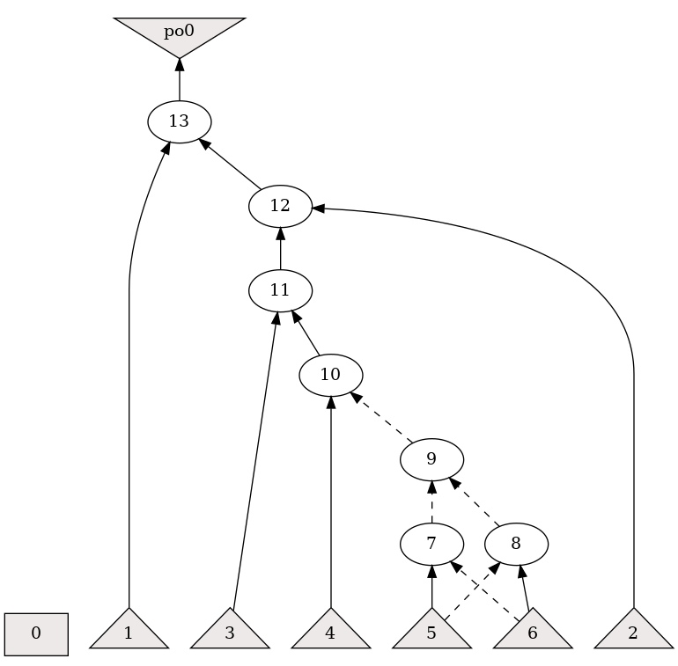
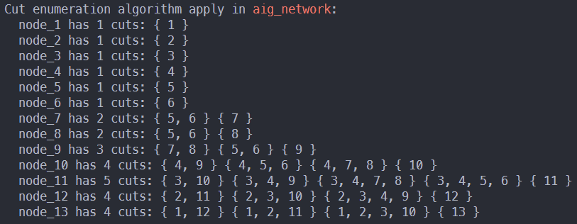

Slide 7
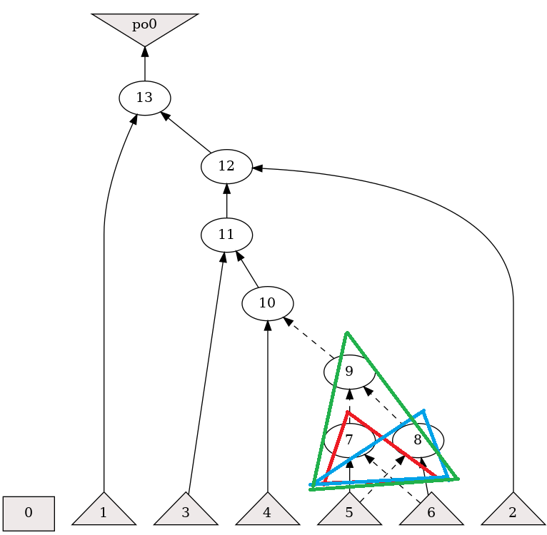

Slide 8
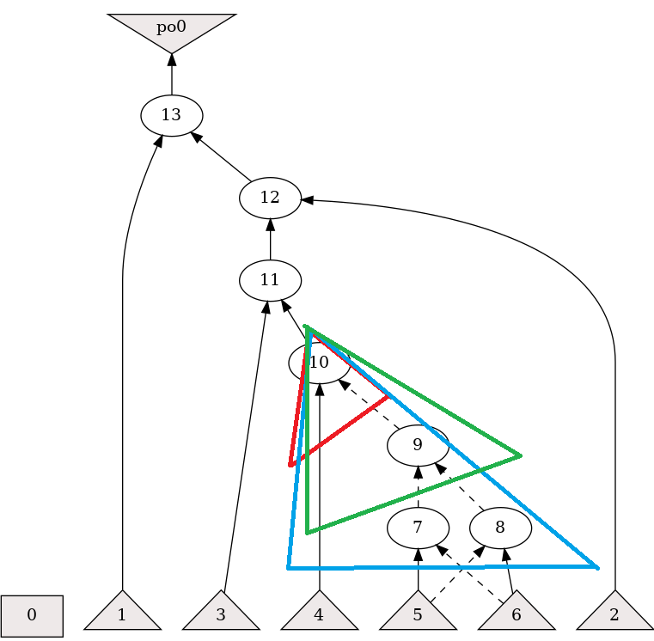

Slide 9
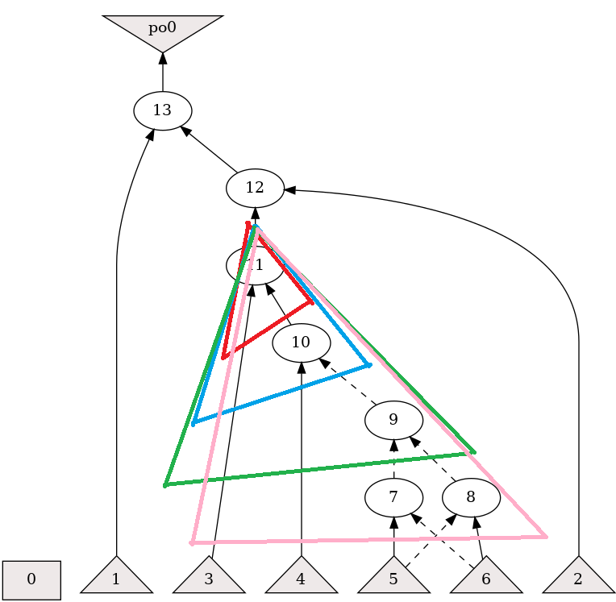

Slide 10
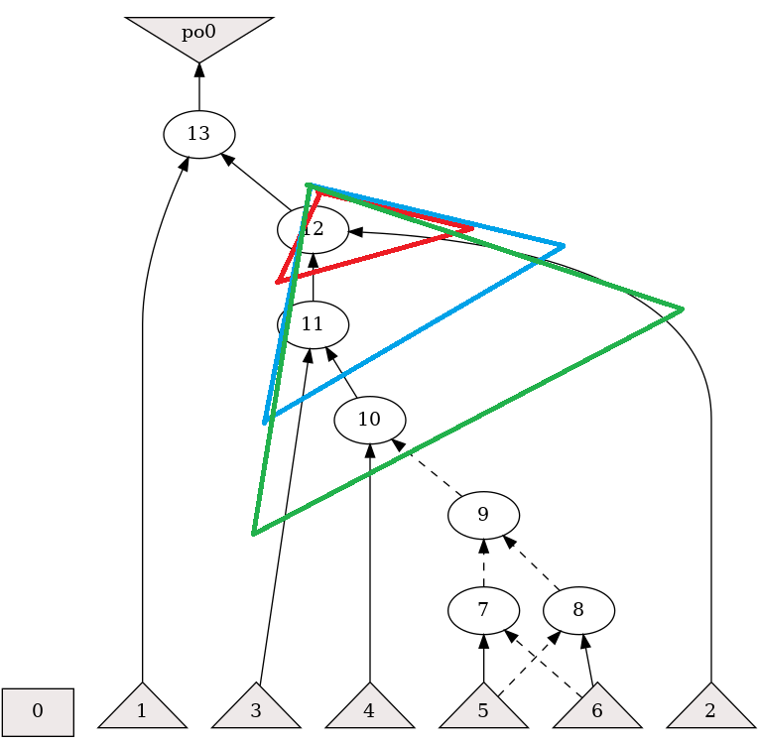

Slide 11
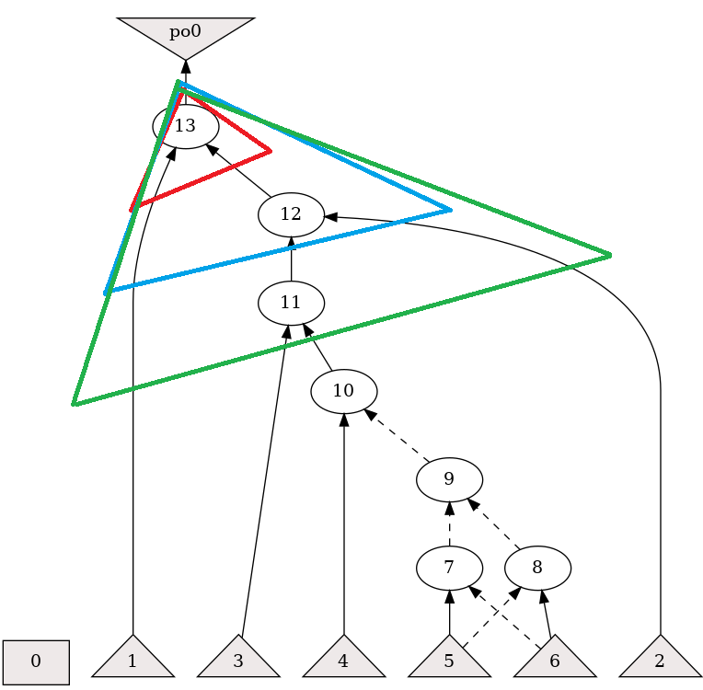

Slide 12
Matching
Boolean matching
Compute cut’s logic function in NPN-canonical form. (Time-consuming job)
Up to 6-inputs
Pattern matching
Tree covering (Fast)
Graph isomorphism (Slow, intractable)

Slide 13
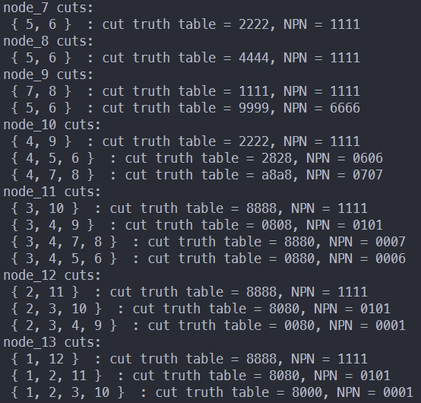
Matching

Slide 14
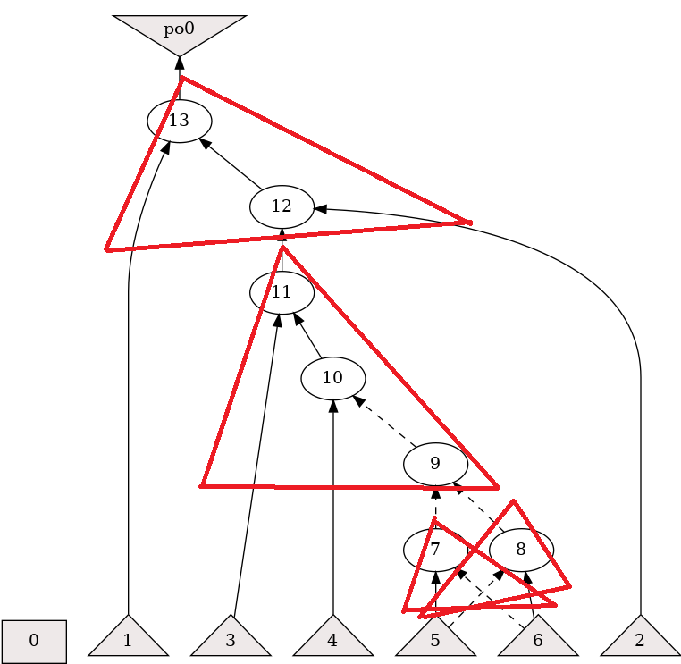
AIG Cover
each node in the network is covered by at least one cut matching cuts to the technology library using Boolean matching or Pattern matching
the root of each cut in the cover is either a PO of the network or a leaf of one or more cuts in the cover

Slide 15


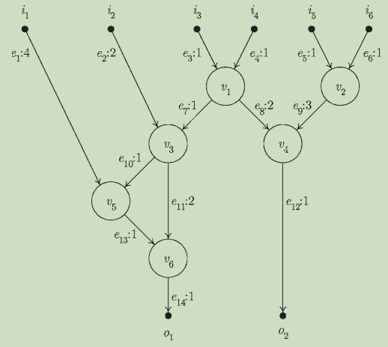
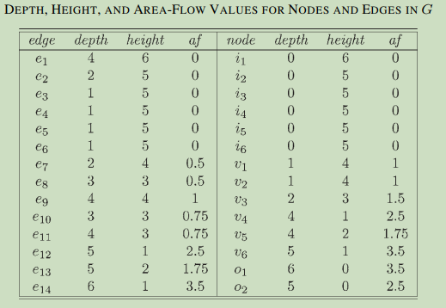
Area flow

Slide 16
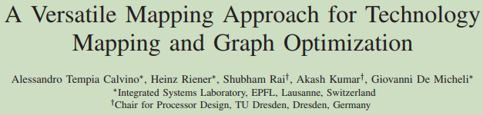
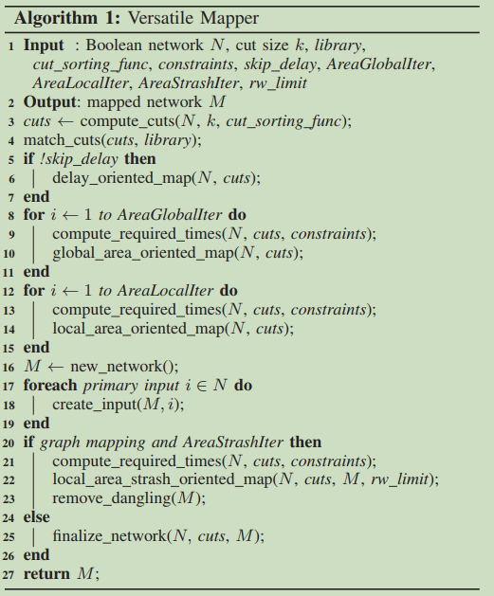
Mockturtle map
Features:
Subject graph can be any network (AIG, XMG, MIG…)
Can perform both delay-driven and area-driven mapping, controlled by the compile-time flag.
A load-independent mapper.

Slide 17
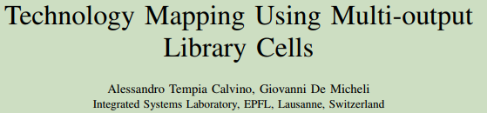
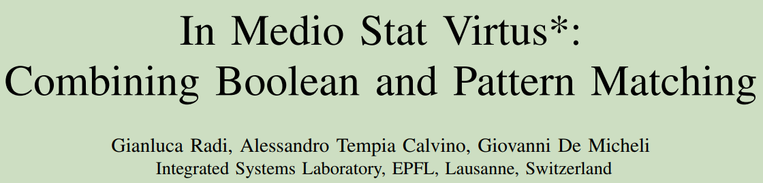
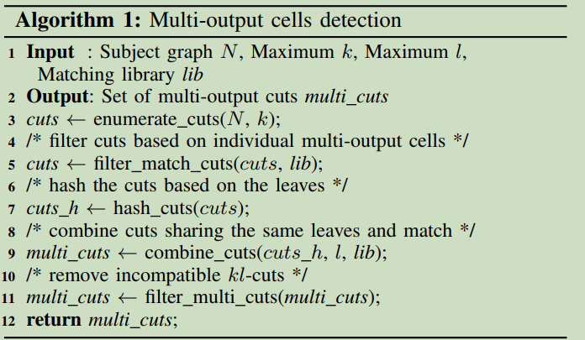
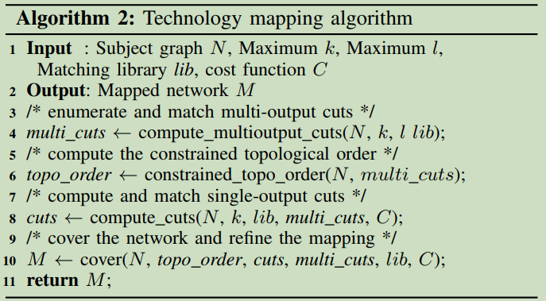
Mockturtle emap
Features:
Support multi-output cell mapping
Hybrid Boolean and Pattern matching

Slide 18
Reference
Cong, Jason, and Yuzheng Ding. "FlowMap: An optimal technology mapping algorithm for delay optimization in lookup-table based FPGA designs." IEEE Transactions on Computer-Aided Design of Integrated Circuits and Systems 13.1 (1994): 1-12.
Calvino, Alessandro Tempia, et al. "A versatile mapping approach for technology mapping and graph optimization." 2022 27th Asia and South Pacific Design Automation Conference (ASP-DAC). IEEE, 2022.
Calvino, Alessandro Tempia, and Giovanni De Micheli. "Technology mapping using multi-output library cells." 2023 IEEE/ACM International Conference on Computer Aided Design (ICCAD). IEEE, 2023.
Radi, Gianluca, Alessandro Tempia Calvino, and Giovanni De Micheli. "In Medio Stat Virtus*: Combining Boolean and Pattern Matching." 2024 29th Asia and South Pacific Design Automation Conference (ASP-DAC). IEEE, 2024.

